Slide 1
Project structure
Università di Modena e Reggio Emilia

Slide 2
Introduction
Android studio (gradle) create for us the entire project structure, now we will go see how it is structured and how create and modify new resources.
In project we can find different files: xml, java, kotlin and gradle.

Slide 3
XML’s pills
XML stands for 'eXtensible Markup Language'. It is a markup language used to structure, store, and transfer data. It was designed to be readable by both humans and machines and is widely used for creating structured documents such as web pages, technical documents, scientific data, and many other types of digital content. In XML, data is organized into elements, which can contain attributes, text, and other nested elements, and their content is described using tags that indicate their meaning.
Comments
<!-- commento -->
Value is assigned to respective tag. Nested tag are allowed.
Tag are unique and represent the id of binded to a value
<root_tag>
<tag1> value </tag1>
<tag2> value </tag2>
</root_tag>

Slide 4
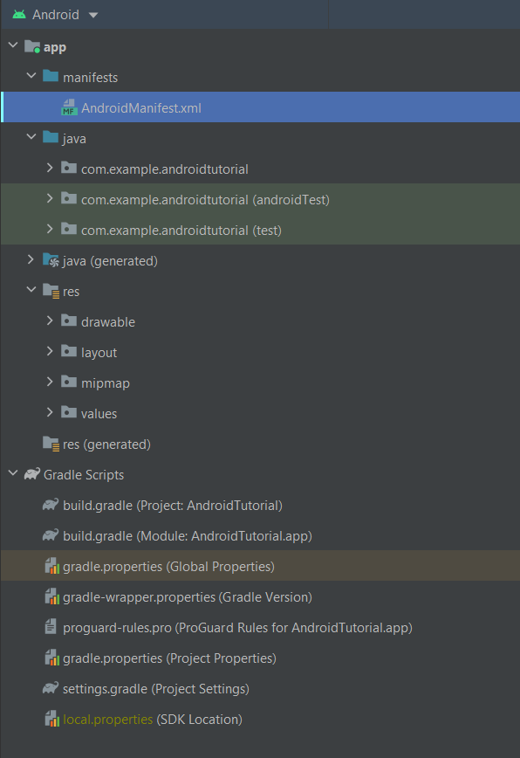
Project structure
The structure of project created by Gradle for you contains:
Manifest folder: contains AndroidManifest.xml file
Java folder: contains java code and test
Res folder: contains resources that you can use in your app
Gradle scripts: contains directives for Gradle

Slide 5
AndroidManifest.xml
Describes essential information about your app.
Contains:
App's package name
App’s components (Activities, Services …) each of them must define basic properties (e.g. name of java class)
Permission
Hardware and software the app reqires
https://developer.android.com/guide/topics/manifest/manifest-intro
<?xml version="1.0" encoding="utf-8"?> <manifest xmlns:android="http://schemas.android.com/apk/res/android" package="com.example.androidtutorial"> <application android:allowBackup="true" android:fullBackupOnly="true" android:icon="@mipmap/ic_launcher" android:label="@string/app_name" android:roundIcon="@mipmap/ic_launcher_round" android:supportsRtl="true" android:theme="@style/Theme.AndroidTutorial"> <activity android:name=".IntroActivity" android:exported="true"> <intent-filter> <action android:name="android.intent.action.MAIN" /> <category android:name="android.intent.category.LAUNCHER" /> </intent-filter> </activity> </application> </manifest>

Slide 6
Manifest structure
manifest is the root tag
You can add other top level tag:
Uses-feature: to specify hardware and software features your applicatione requires. (e.g. audio, NFC, fingerprint)
<uses-feature android:name="android.hardware.NFC"/>
Uses-permission: part of security application model, each node declare the user permission application requires. Each of them will be presented to the user while application is running. User can accept or refuse them
<uses-permission android:name= "android.permission.ACCESS_FINE_LOCATION"/>
<?xml version="1.0" encoding="utf-8"?> <manifest xmlns:android="http://schemas.android.com/apk/res/android" xmlns:tools="http://schemas.android.com/tools" package="com.app">
<uses-permission android:name="android.permission. ACCESS_FINE_LOCATION"/>
<uses-feature android:name="android.hardware.NFC"/>
<application ….> <activity android:name=".MainActivity" android:exported="true"> <intent-filter> <action android:name="android.intent.action.MAIN" /> <category android:name="android.intent.category.LAUNCHER" /> </intent-filter> </activity> </application> </manifest>

Slide 7
Manifest structure (2)
In application node are specified application metadata (e.g. name, icon, theme …) and contains tags:
Activity: is required for every activity within your application. You can define activity name (required) and intent-filter tag, that define Intent that can be used to start activity (e.g. first activty show when system run the app)
<activity android:name=".IntroActivity" android:exported="true"> <intent-filter> <action android:name="android.intent.action.MAIN" /> <category android:name="android.intent.category.LAUNCHER"/> </intent-filter> </activity>
Service: is required for every service class.
<service android:name=".MyService" />
Provider: is required for every content provider class (used to manage database access)
<provider
android:name=".MyContentProvider"
android:authorities="com.example.AndroidProgramming" />
Receiver: is required for every broadcast receiver class (are global event listener)
<receiver android:name=".MyIntentReceiver" />

Slide 8
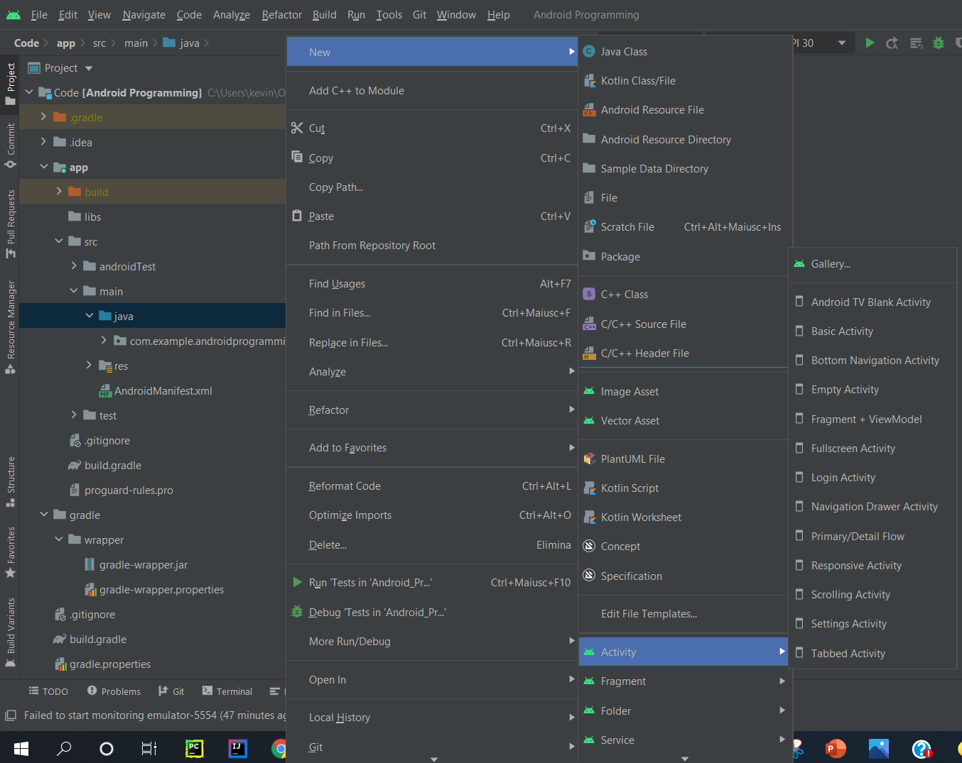
Application code
Application code written in Java are located in java folder
Android studio provide an easy way to create code element such us activities ora class
Right click on java folder -> new

Slide 9
App resources
Android app contains resources separated from the source code you can define with XML:
Styles: defines the format and look for a UI.
Colors: list of exadecimal code of colors
Strings
Dimensions
Simple resources, like colors, string, styles and dimensions, are located in values folder
Drawables (image file .png ecc…, audio files, and other graphic components)
Layouts: files that define a user interface layout.
Animations
Menus
Mipmap: Drawable files for different launcher icon densities.
Font
Xml: generic xml files
https://developer.android.com/guide/topics/resources/providing-resources

Slide 10
Layout
Layout files describe the architecture of UI.
Contains:
ViewGroup: A container for other View elements. (LinearLayout, ConstraintLayout …)
View: An individual UI component (Button, TextView…)
Each UI elements has attributes like:
unique id.
Dimension
Position in the layout
You can include layout into another-one using the id and the directive <include>
Sintassi generica:
<?xml version="1.0" encoding="utf-8"?> <ViewGroup xmlns:android="http://schemas.android.com/apk/res/android" android:id="@[+][package:]id/resource_name" android:layout_height=["dimension" | "match_parent" | "wrap_content"] android:layout_width=["dimension" | "match_parent" | "wrap_content"] [ViewGroup-specific attributes] >
<View android:id="@[+][package:]id/resource_name" android:layout_height=["dimension" | "match_parent" | "wrap_content"] android:layout_width=["dimension" | "match_parent" | "wrap_content"] [View-specific attributes] > </View> <ViewGroup > <View /> </ViewGroup> <include layout="@layout/layout_resource"/> </ViewGroup>

Slide 11
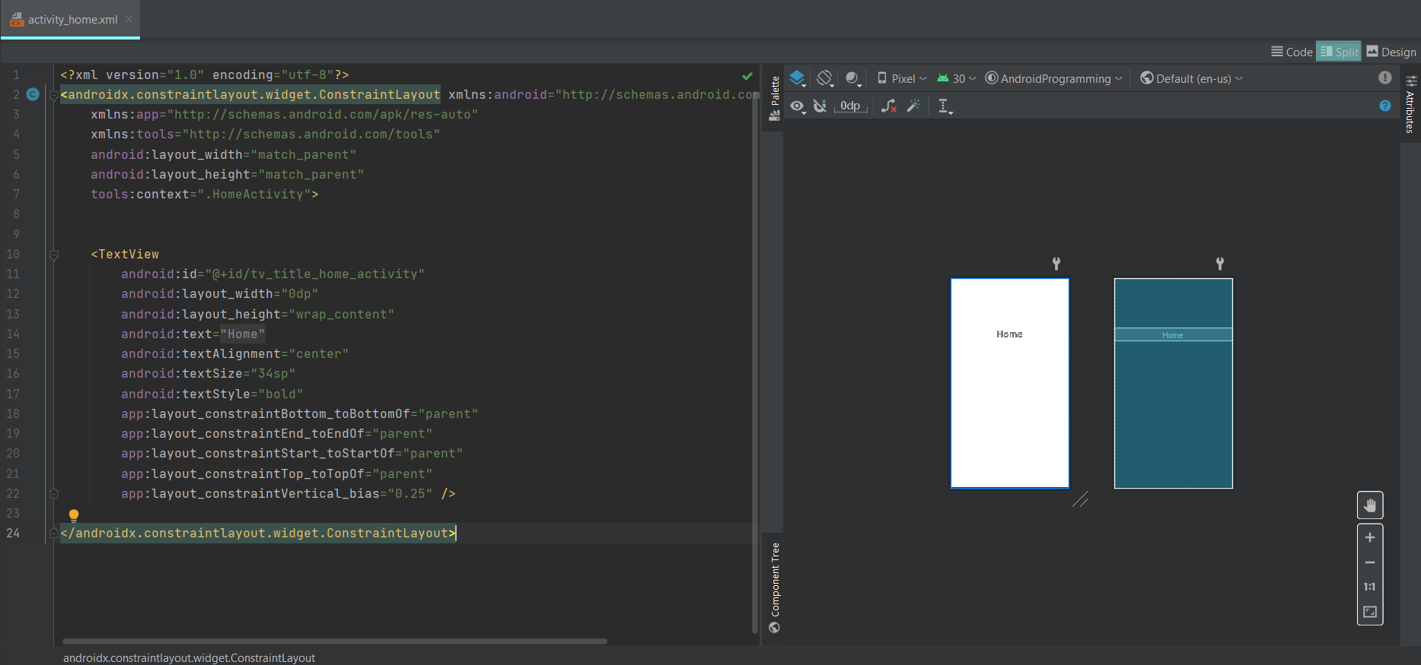
Layout example

Slide 12
String.xml files
<resources> root tag
You can define more than one string for file, you have to define string name
You can also define string array
<resources> <string name="app_name">AndroidTutorial </string> <string-array name="week_day"> <item>Monday</item> <item>Tuesday</item> <item>Wednesday</item> <item>Thursday</item> <item>Friday</item> <item>Saturday</item> <item>Sunday</item> </string-array> </resources>

Slide 13
Colors.xml files
<resources> root tag
Colors are defined by name and exadecimal code
#AARRGGBB
AA defines transparency
RR, GG, BB defines red, green and blue parts
<?xml version="1.0" encoding="utf-8"?> <resources> <color name="purple_200">#FFBB86FC</color> <color name="purple_500">#FF6200EE</color> <color name="purple_700">#FF3700B3</color> <color name="teal_200">#FF03DAC5</color> <color name="teal_700">#FF018786</color> <color name="black">#FF000000</color> <color name="white">#FFFFFFFF</color> </resources>

Slide 14
Dimensions.xml files
<resources> root tag
In Android app, is best practise use dp (density independente pixels) to measurements to define dimensions
You have to declare name and value
<?xml version="1.0" encoding="utf-8"?> <resources>
<dimen > name="title_size">32dp</dimen>
</resources>

Slide 15
Style
<resources> root tag
Styles file contains all available styles that you can use in application.
A style resource defines the format and look for a UI. It can be applied to a single view or to an entire activity or application in manifest file
Style has required attributes:
Name
Parent: define style hierarchy
Is possible customize a style by adding extra attributes
<resources xmlns:tools="http://schemas.android.com/tools"> <!-- Base application theme. --> <style name="Theme.AndroidProgramming" parent="Theme.MaterialComponents.DayNight.DarkActionBar"> <!-- Primary brand color. --> <item name="colorPrimary">@color/purple_500</item> <item name="colorPrimaryVariant">@color/purple_700</item> <item name="colorOnPrimary">@color/white</item> <!-- Secondary brand color. --> <item name="colorSecondary">@color/teal_200</item> <item name="colorSecondaryVariant">@color/teal_700</item> <item name="colorOnSecondary">@color/black</item> <!-- Status bar color. --> <item name="android:statusBarColor" tools:targetApi="l">?attr/colorPrimaryVariant</item> <!-- Customize your theme here. --> </style> </resources>

Slide 16
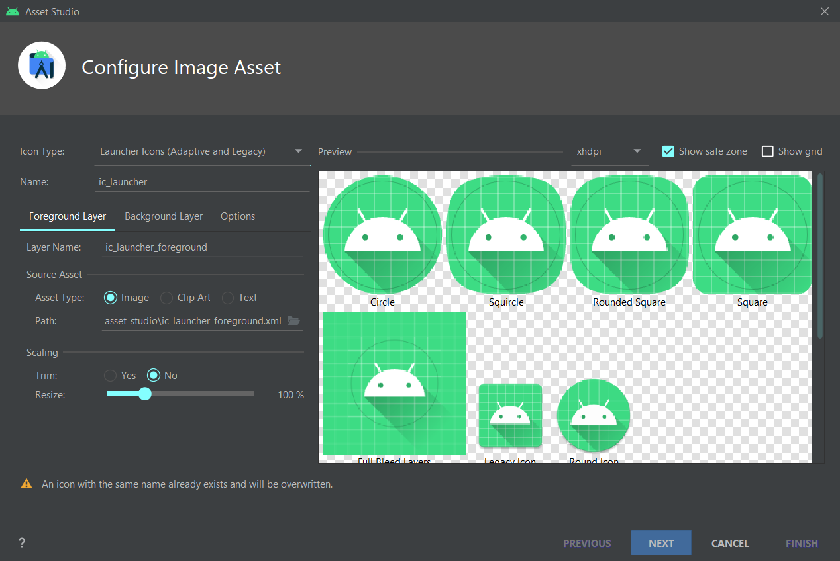
Image Asset creation
Android Studio includes a tool called Image Asset Studio that helps you generate your own app icons. It generates a set of icons at the appropriate resolution which are placed in res folder
You have to define
Icon type: launch icon, notification icon, action bar or tab icon
Foreground, background and text icon
Path
https://developer.android.com/studio/write/image-asset-studio

Slide 17
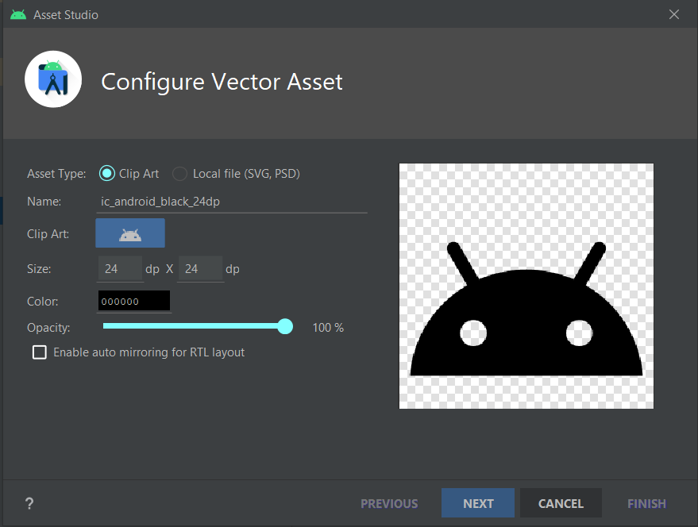
Vector Asset creation
Vector Asset Studio adds a vector graphic to the project as an XML file that describes the image. Maintaining one XML file can be easier than updating multiple raster graphics at various resolutions.
Vector asset was introduced in Android 4, for background compatibility asset file is located in drawable folder
You have to define:
Clip art: from list that android provide to you
Size
Color
Opacity
https://developer.android.com/studio/write/vector-asset-studio

Slide 18
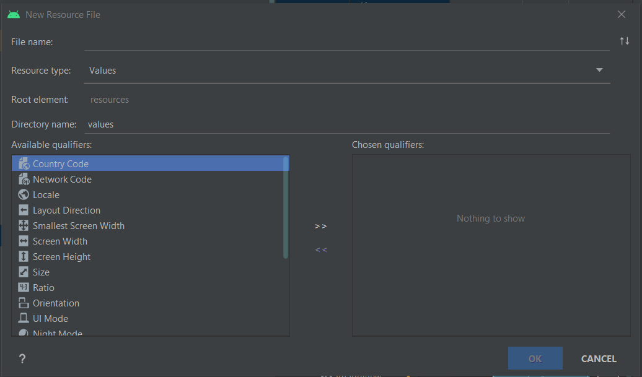
Resources creation
Right click on res folder -> new -> Android resource file
You have to define:
File name
Resource type
Root elemenet (root tag in xml file)
Qualifiers: could be Language (if you are developing multi-language app), hardware or system requirements (such as screen dimension or Android version)

Slide 19
How to access resources?
All resources con be used in application code or can also be referenced from other resources.
Each resource have a unique Id and are mappend in resource table
Using resources in code: you access to resources using the R class, which is auto-generated when your project is built. R class contains sub classes for each of the available resources.
R.resourceType.resourceId return the resource's location in the resource table, not an instace of the resource
Resource table is represented as an instance of Resources class, you can access to apllication's Resources instance using getResources method, and you can access to specific resources using Resources getter and specific resource id.
Resources myRes = getResources()
CharSequence appName = myRes.getText(R.string.app_name)

Slide 20
How to access resources? (2)
Referencing resources within resources: resources can be used as attribute values in other XML resources using the @ notation
@[packagename:]resourceType/resourceId
<TextView
android:name="@+id/tv_title"
android:text="@string/app_name"
android:textSize="@dimen/title_size"
/>

Slide 21
System resources
Android framework provide you many native resources like string, images, styles and layouts.
Android resources are available from android.R class, that you can use in application code
You can use anroid resource als in your resources's files using different @ notation
@android:resourceType/resourceId

Slide 22
Gradle scripts
All files are Gradle application building directives:
Project scoped Settings.gradle: defines which module should be included when building application (your applicantion should be composed by more than one module)
Project scoped Build.gradle: contains dependencies that apply to the entire project and all its module (e.g default configurisation contain Jcenter and Google repositories and gradle dependencies)
Module scoped build.gradle: used to configure build settings for your applications, one for each application module
FOR MOST APPLICATION, SETTING AND PROJECT SCOPED BUILD FILE WON'T NEED TO BE CHANGED

Slide 23
Module Build.gradle file
plugins { id 'com.android.application' } android { compileSdk 30 defaultConfig { applicationId "com.example.androidprogramming" minSdk 21 targetSdk 30 versionCode 1 versionName "1.0" testInstrumentationRunner "androidx.test.runner.AndroidJUnitRunner" } buildTypes { release { minifyEnabled false proguardFiles getDefaultProguardFile('proguard-android-optimize.txt'), 'proguard-rules.pro' } } compileOptions { sourceCompatibility JavaVersion.VERSION_1_8 targetCompatibility JavaVersion.VERSION_1_8 } } dependencies { implementation 'androidx.appcompat:appcompat:1.3.1' implementation 'com.google.android.material:material:1.4.0' implementation 'androidx.constraintlayout:constraintlayout:2.1.1' testImplementation 'junit:junit:4.+' androidTestImplementation 'androidx.test.ext:junit:1.1.3' androidTestImplementation 'androidx.test.espresso:espresso-core:3.4.0' }
Contains:
App id
App properties:
MinSdk: minumum API’s version that target device must support
versionCode
versionName
App dependencies

